Slide 1
CODE INNOVATION SERIES – K S Institute of Technology

Slide 2
PROBLEM STATEMENT
The problem statement we have chosen is Education.
After completion of 10th or PU, many students are clueless about what course they have to choose and don’t know what course to choose.
Students don’t know if they will be interested in the course they choose and they might not get a job.
Many students don’t know what competitions are going on in their field.
Finding internship has been a hard task for students who are studying at an University level.
They don’t know what skills they need to have to get a job or pursue their career.

Slide 3
SOLUTION TO THE PROBLEM
We will build a website to provide information to guide them throughout their education and career.
There is not one website or an app which provides all the required information at one place.
The website will contain all the courses available in an organized manner.
It will give information about the different paths in their education.
It will also provide a detailed description of courses, their pros and cons, the job it will fetch.
It will notify all the competitions, internship opportunities, etc.
It will provide information about what skills are required for a job.

Slide 4
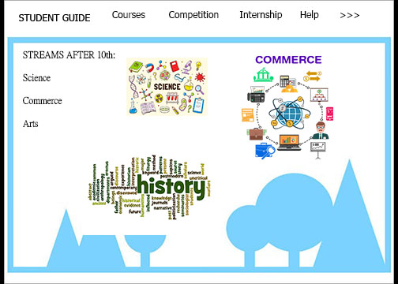

Slide 5
TEAM DETAILS
Team name: Code Brigade
Team size: 4
Team members:
Prajwal Kulkarni (III B)
Preethi KP (III B)
Shreesha S (III B)
Akshay R (III B)

